Slide 1

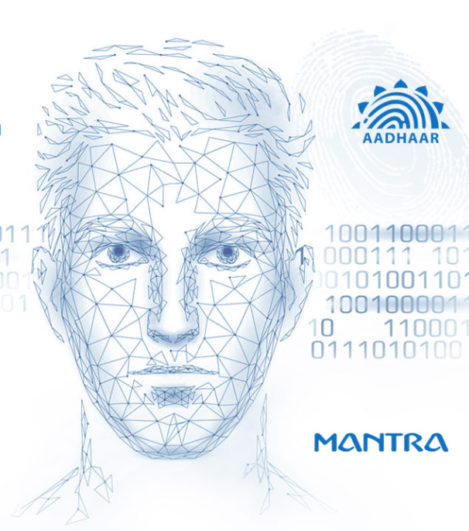





AI-BASED FRAUD MANAGEMENT SYSTEM FOR UID AADHAAR
AN AI-POWERED FRAUD DETECTION SYSTEM DESIGNED TO ENHANCE THE SECURITY OF THE UID AADHAAR VERIFICATION PROCESS.
PRESENTATION-2025
Prepared By:
Interns Team

Slide 2




PAGE 1
OVERVIEW OF THE PROJECT
Developed an advanced fraud detection system leveraging OCR technology. Integrated classification, detection, and OCR models to identify fraudulent Aadhaar documents with high accuracy. The system automates document verification, ensuring security and efficiency in identity validation.
A team of interns developing an OCR-based fraud detection system for UID Aadhaar, integrating classification and detection models for secure and efficient identity verification.

Slide 3



Importance of Fraud Detection in Aadhaar Verification
PAGE 2
Protection Against Identity Theft
Maintaining Public Trust
Compliance with Regulations
Effective fraud detection mechanisms safeguard individuals from unauthorized access to their personal information and prevent identity theft in the Aadhaar system.
Robust fraud detection enhances public confidence in the Aadhaar system, ensuring that citizens feel secure in sharing their biometric data for essential services.
Implementing fraud detection aligns with legal and ethical standards, ensuring that personal data is handled responsibly and in accordance with privacy laws.

Slide 4





PAGE 3
GOAL AND OBJECTIVES
Our goal is to enhance the security and reliability of UID Aadhaar verification by developing an advanced fraud detection system. Using OCR, classification, and detection models, we aim to automate document verification, prevent identity fraud, and ensure a seamless and trustworthy authentication process.
PROBLEM STATEMENT
Fraudulent UID Aadhaar documents pose security risks, and manual verification is slow and error-prone. An AI-driven solution is needed to automate detection, classification, and verification, ensuring accurate and efficient fraud prevention

Slide 5





PAGE 4
SOLUTION
An AI-powered fraud detection system for UID Aadhaar using OCR, classification, and detection models. This system automates document verification, accurately identifying fraudulent documents to enhance security, reduce manual effort, and improve the efficiency of identity authentication.
AI models
Efficiency
Convenient Security

Slide 6
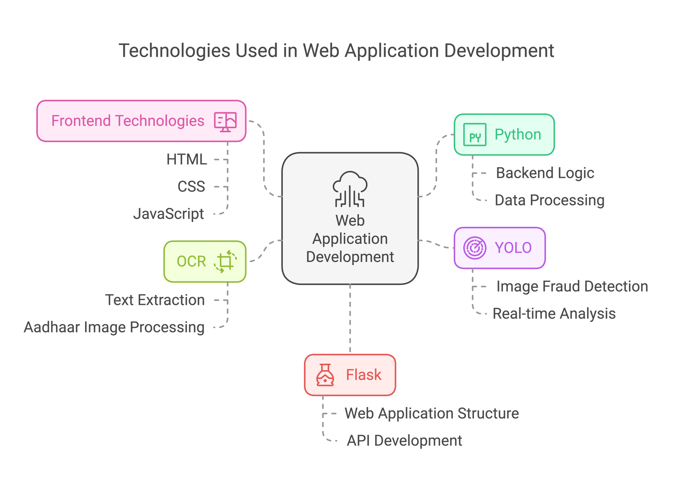
PAGE 5

Slide 7

PAGE 6
PROJECT WORKFLOW
Generating output from input has the following steps-
1
Document Classification
3
OCR Processing
The model identifies whether the document is an Aadhaar card. If it's not, the process ends; if it is, it moves to the next step.
ext is extracted from the document using OCR for comparison and verification.
2
Image Detection
4
Matching & Output
The detection model scans the Aadhaar document for any signs of tampering or anomalies.
The extracted data is compared to verify authenticity, and the results, including matching scores, are provided in an Excel file.

Slide 8


PAGE 7
ZIP files
UPLOADING FILES
Excel files
Users provide a ZIP file with Aadhaar images and an Excel file with metadata. The system classifies the images, detects tampering, and extracts text via OCR. It compares the extracted data with the metadata and generates an output Excel file with matching scores and fraud detection results.
Easy input
Efficient output

Slide 9
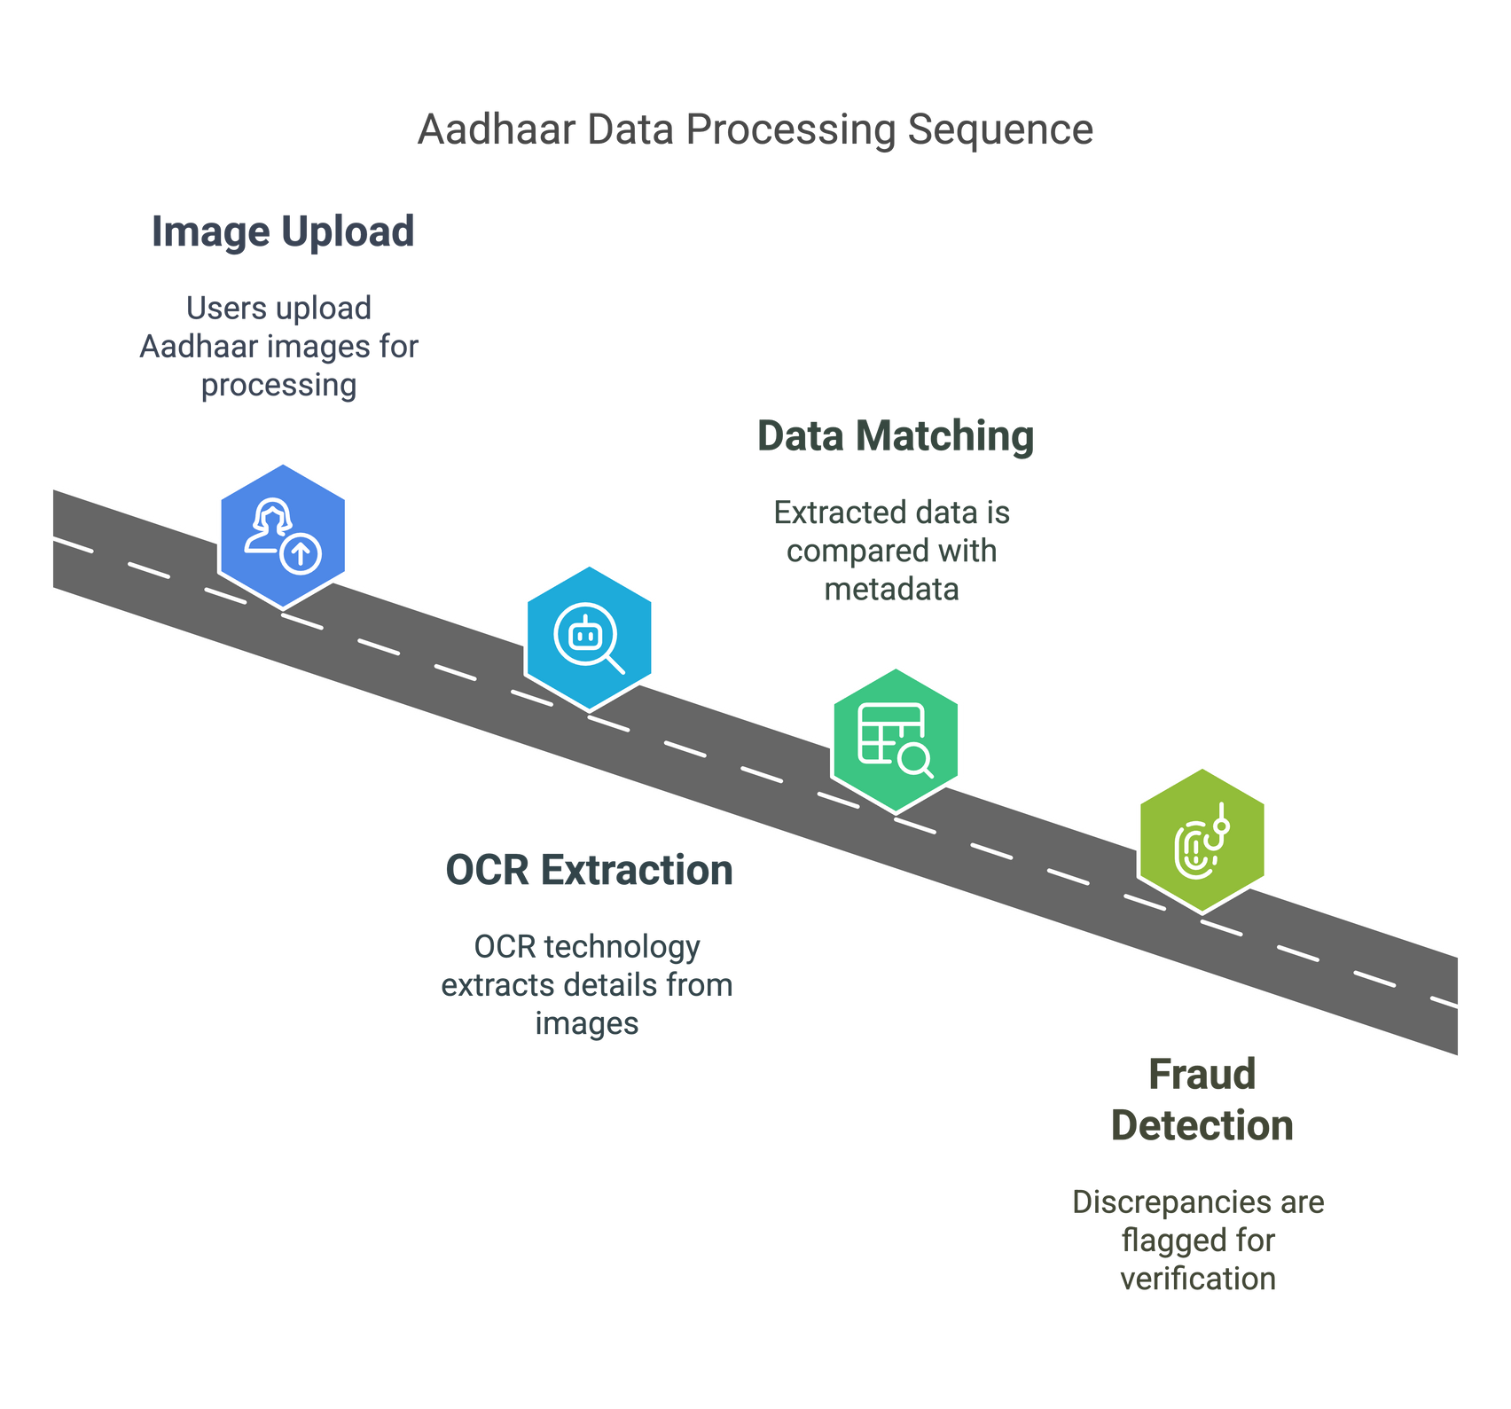

PAGE 8
Processing Aadhaar Data
OCR extracts key details (Name, UID, DOB, Address) from uploaded Aadhaar images
Extracted details are compared with metadata from the Excel database
Any mismatch or discrepancy is flagged for further verification.

Slide 10


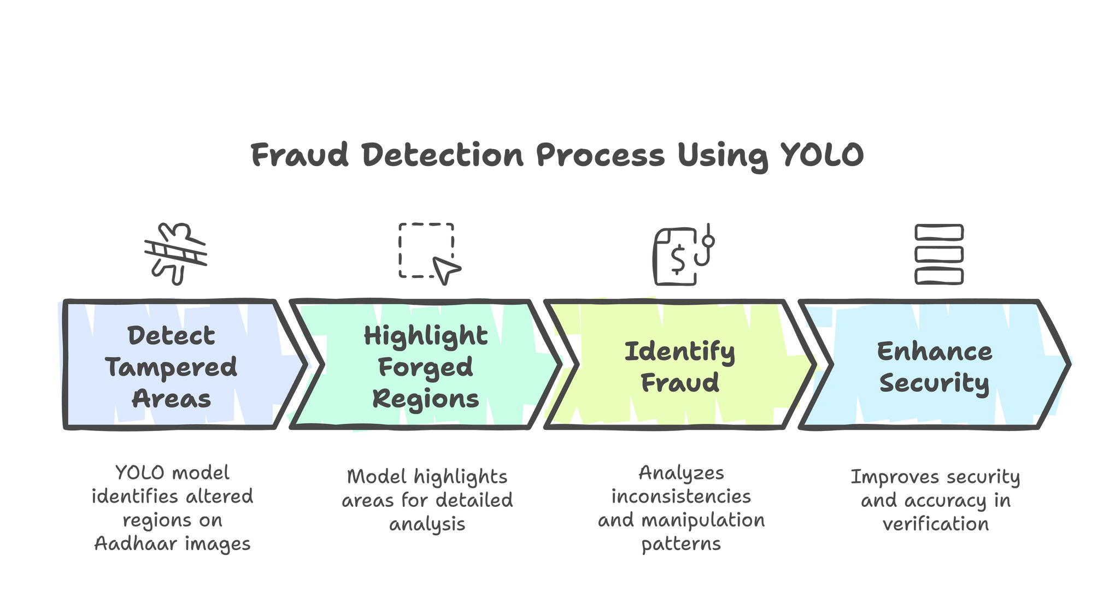
PAGE 9
Fraud Detection Using YOLO
YOLO model detects tampered areas on Aadhaar images.
Highlights forged or altered regions for detailed analysis.
Identifies fraud by analyzing and manipulation patterns.
Enhances security and accuracy in Aadhaar verification.

Slide 11

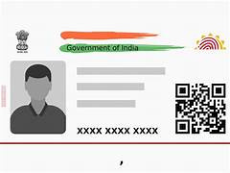


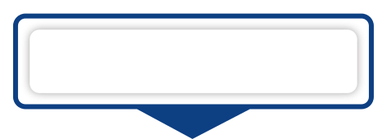
PAGE 10
Displaying Results
The user uploads Aadhaar images and an Excel file, which are processed using classification, detection, and OCR models to extract and verify details. The backend compares the data, generates match scores, provides JSON results for the frontend, and allows users to download the final results.xlsx file.
Processing Aadhar Data
Generate Results
Displaying Results
The user uploads Aadhaar images and an Excel file, which are processed using classification, detection, and OCR models to extract and verify details.
Extracted data is compared with the Excel file, match scores are calculated, and a `results.xlsx` file is created with remarks like "All matched" or "UID mismatch."
The backend returns JSON results for the frontend to display, and users can download the full results via the `/download` endpoint.

Slide 12
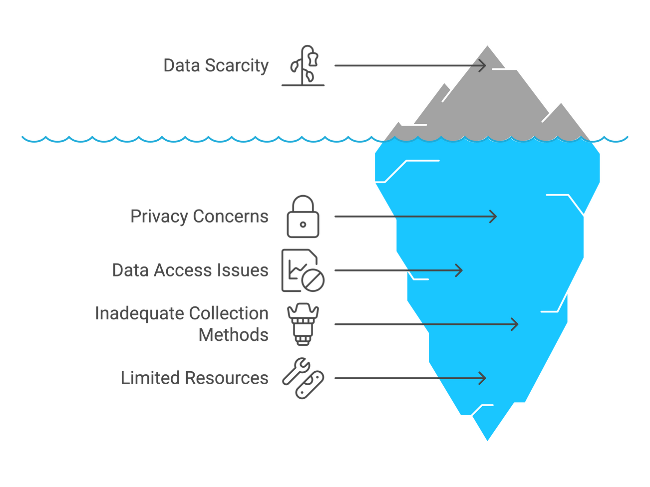

PAGE 11
Challenges Faced
During our project, we faced several challenges, including the lack of publicly available Aadhaar datasets, making data collection difficult. Optimizing the YOLO model for accurate fraud detection required extensive fine-tuning. Ensuring OCR accuracy was another hurdle due to variations in Aadhaar font styles and text clarity.
Data Collection: Limited publicly available Aadhaar datasets.
Model Optimization: Fine-tuning YOLO for precise fraud detection.
OCR Accuracy: Managing variations in font styles and text clarity.

Slide 13



PAGE 12
Future Enhancements
Future enhancements include improving OCR accuracy, adding multilingual support, and developing a web-based dashboard for better result visualization. AI-driven anomaly detection and real-time processing can enhance data validation and efficiency. Cloud integration and API support will enable secure storage and third-party integration. Enhanced security measures like encryption will ensure data protection.
Enhanced OCR Accuracy & Multilingual Support
Cloud Integration & Secure Storage
Web-Based Dashboard & Data Visualization
Real-Time Aadhaar Verification
AI-Driven Data Validation & Fraud Detection
API & Security Enhancements

Slide 14



PAGE 13
Integration Possibilities
Government Agencies – A graphic of Aadhaar authentication or a government security system.
Banking & Financial Sector – A digital payment authentication image or a fraud detection alert in banking.
E-KYC Providers – A verification process illustration with Aadhaar integration.
Corporate HR Systems – An employee ID verification process image, possibly showing Aadhaar-based authentication.

Slide 15

THANK YOU
For Attending Our Presentation
PRESENTATION-2025

